Slide 1
IP Subnetting – Zero to Hero Public and Private IP Addresses
CyberQuince

Slide 2
Reserved IP Addresses
Not all IP addresses can be used freely.

Slide 3
Reserved IP Addresses
Not all IP addresses can be used freely.
Some IP addresses are reserved for specific use:

Slide 4
Reserved IP Addresses
Not all IP addresses can be used freely.
Some IP addresses are reserved for specific use:
0.0.0.0

Slide 5
Reserved IP Addresses
Not all IP addresses can be used freely.
Some IP addresses are reserved for specific use:
0.0.0.0 (default route)

Slide 6
Reserved IP Addresses
Not all IP addresses can be used freely.
Some IP addresses are reserved for specific use:
0.0.0.0 (default route)
255.255.255.255

Slide 7
Reserved IP Addresses
Not all IP addresses can be used freely.
Some IP addresses are reserved for specific use:
0.0.0.0 (default route)
255.255.255.255 (default broadcast)

Slide 8
Reserved IP Addresses
Not all IP addresses can be used freely.
Some IP addresses are reserved for specific use:
0.0.0.0 (default route)
255.255.255.255 (default broadcast)
127.0.0.0/8

Slide 9
Reserved IP Addresses
Not all IP addresses can be used freely.
Some IP addresses are reserved for specific use:
0.0.0.0 (default route)
255.255.255.255 (default broadcast)
127.0.0.0/8 (localhost)

Slide 10
Reserved IP Addresses
Not all IP addresses can be used freely.
Some IP addresses are reserved for specific use:
0.0.0.0 (default route)
255.255.255.255 (default broadcast)
127.0.0.0/8 (localhost)
169.254.0.0/16

Slide 11
Reserved IP Addresses
Not all IP addresses can be used freely.
Some IP addresses are reserved for specific use:
0.0.0.0 (default route)
255.255.255.255 (default broadcast)
127.0.0.0/8 (localhost)
169.254.0.0/16 (APIPA)

Slide 12
Public and Private IP Addresses
RFC 1918 defines three private network ranges:
https://tools.ietf.org/html/rfc1918

Slide 13
Public and Private IP Addresses
RFC 1918 defines three private network ranges:
10.0.0.0 /8

Slide 14
Public and Private IP Addresses
RFC 1918 defines three private network ranges:
10.0.0.0 /8

Slide 15
Public and Private IP Addresses
RFC 1918 defines three private network ranges:
10.0.0.0 /8
172.16.0.0 /12

Slide 16
Public and Private IP Addresses
RFC 1918 defines three private network ranges:
10.0.0.0 /8
172.16.0.0 /12

Slide 17
Public and Private IP Addresses
RFC 1918 defines three private network ranges:
10.0.0.0 /8
172.16.0.0 /12 → 10101100.00010000.00000000.00000000

Slide 18
Public and Private IP Addresses
RFC 1918 defines three private network ranges:
10.0.0.0 /8
172.16.0.0 /12
192.168.0.0 /16

Slide 19
Public and Private IP Addresses
RFC 1918 defines three private network ranges:
10.0.0.0 /8
172.16.0.0 /12
192.168.0.0 /16

Slide 20
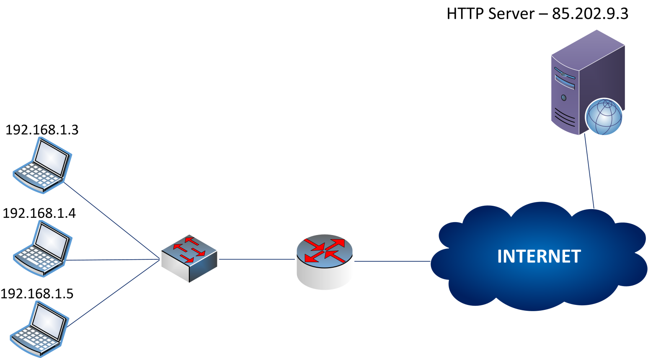
Network Address Translation (NAT)

Slide 21

Network Address Translation (NAT)

Slide 22
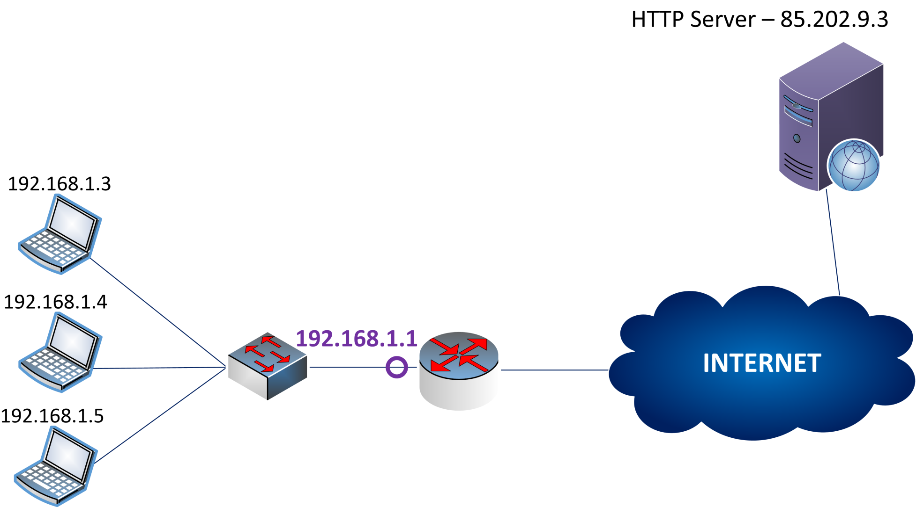
Network Address Translation (NAT)

Slide 23

Network Address Translation (NAT)

Slide 24

Network Address Translation (NAT)

Slide 25
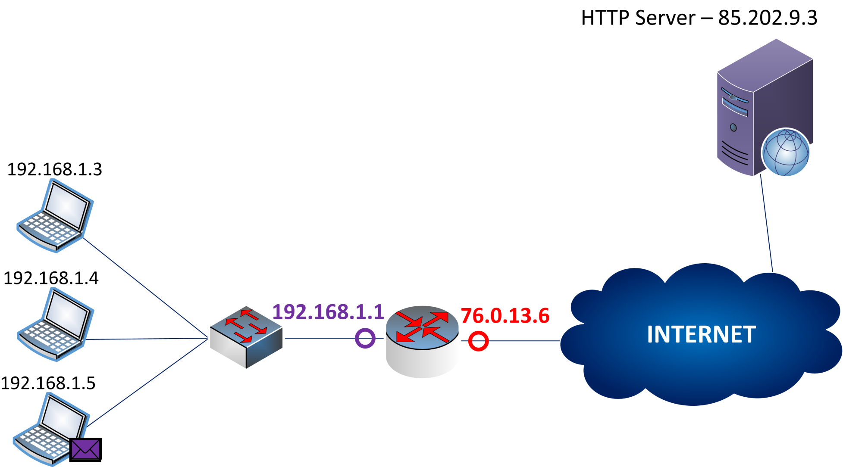
Network Address Translation (NAT)

Slide 26
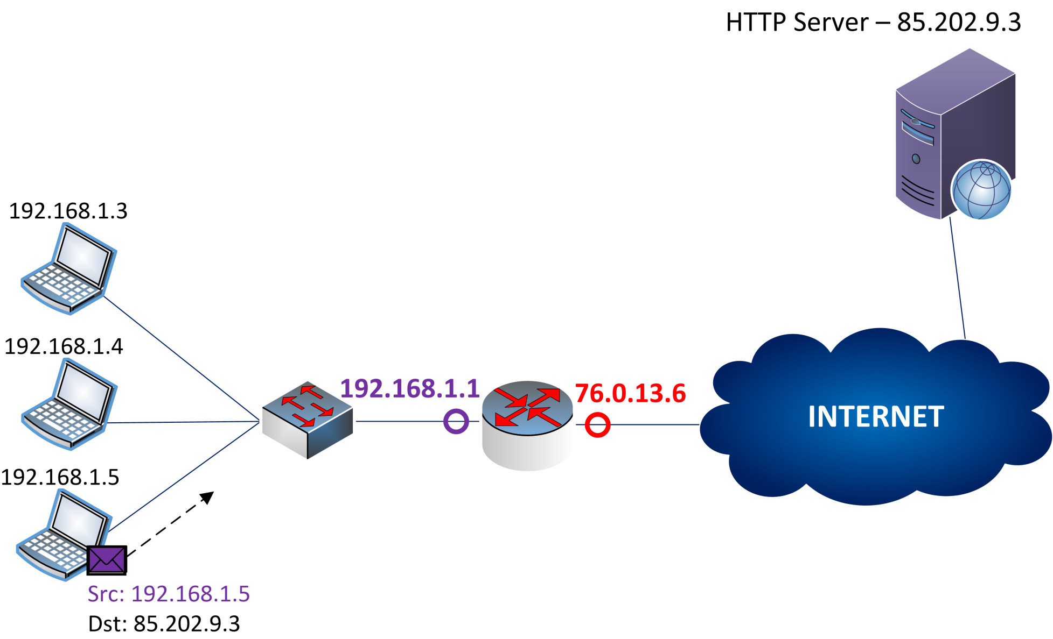
Network Address Translation (NAT)

Slide 27
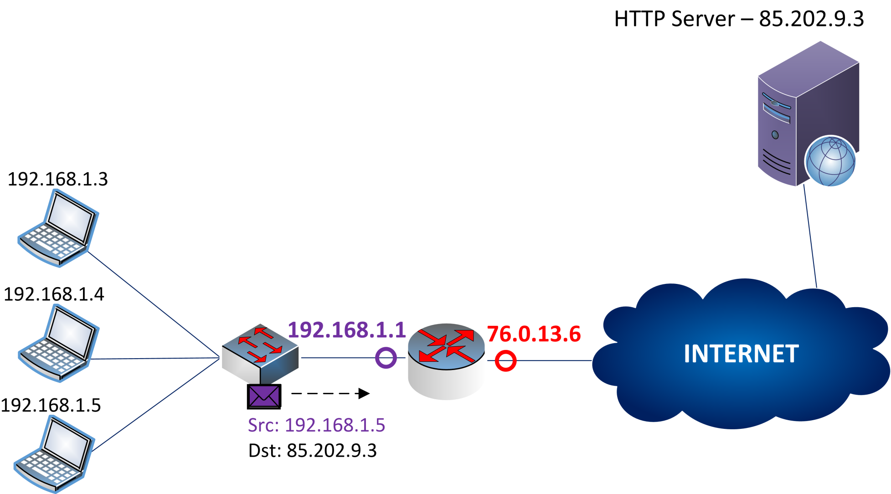
Network Address Translation (NAT)

Slide 28
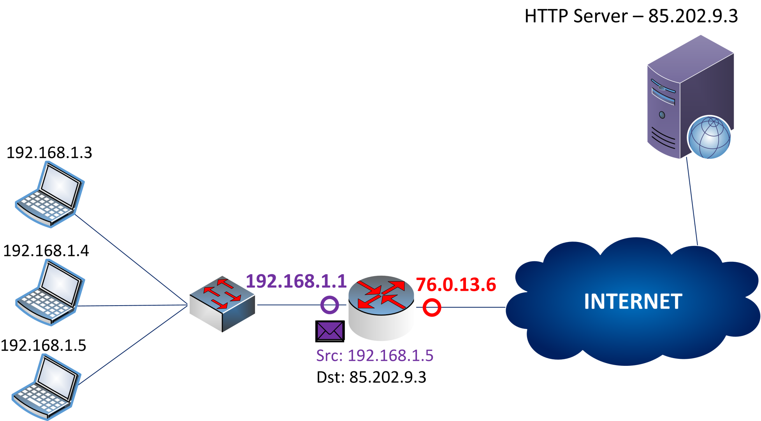
Network Address Translation (NAT)

Slide 29
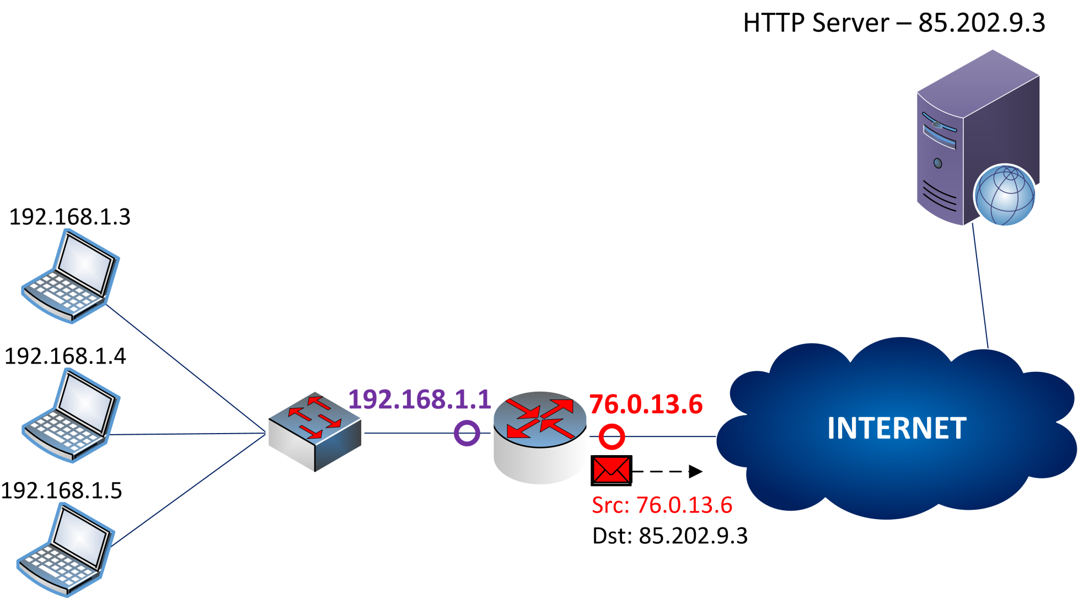
Network Address Translation (NAT)

Slide 30
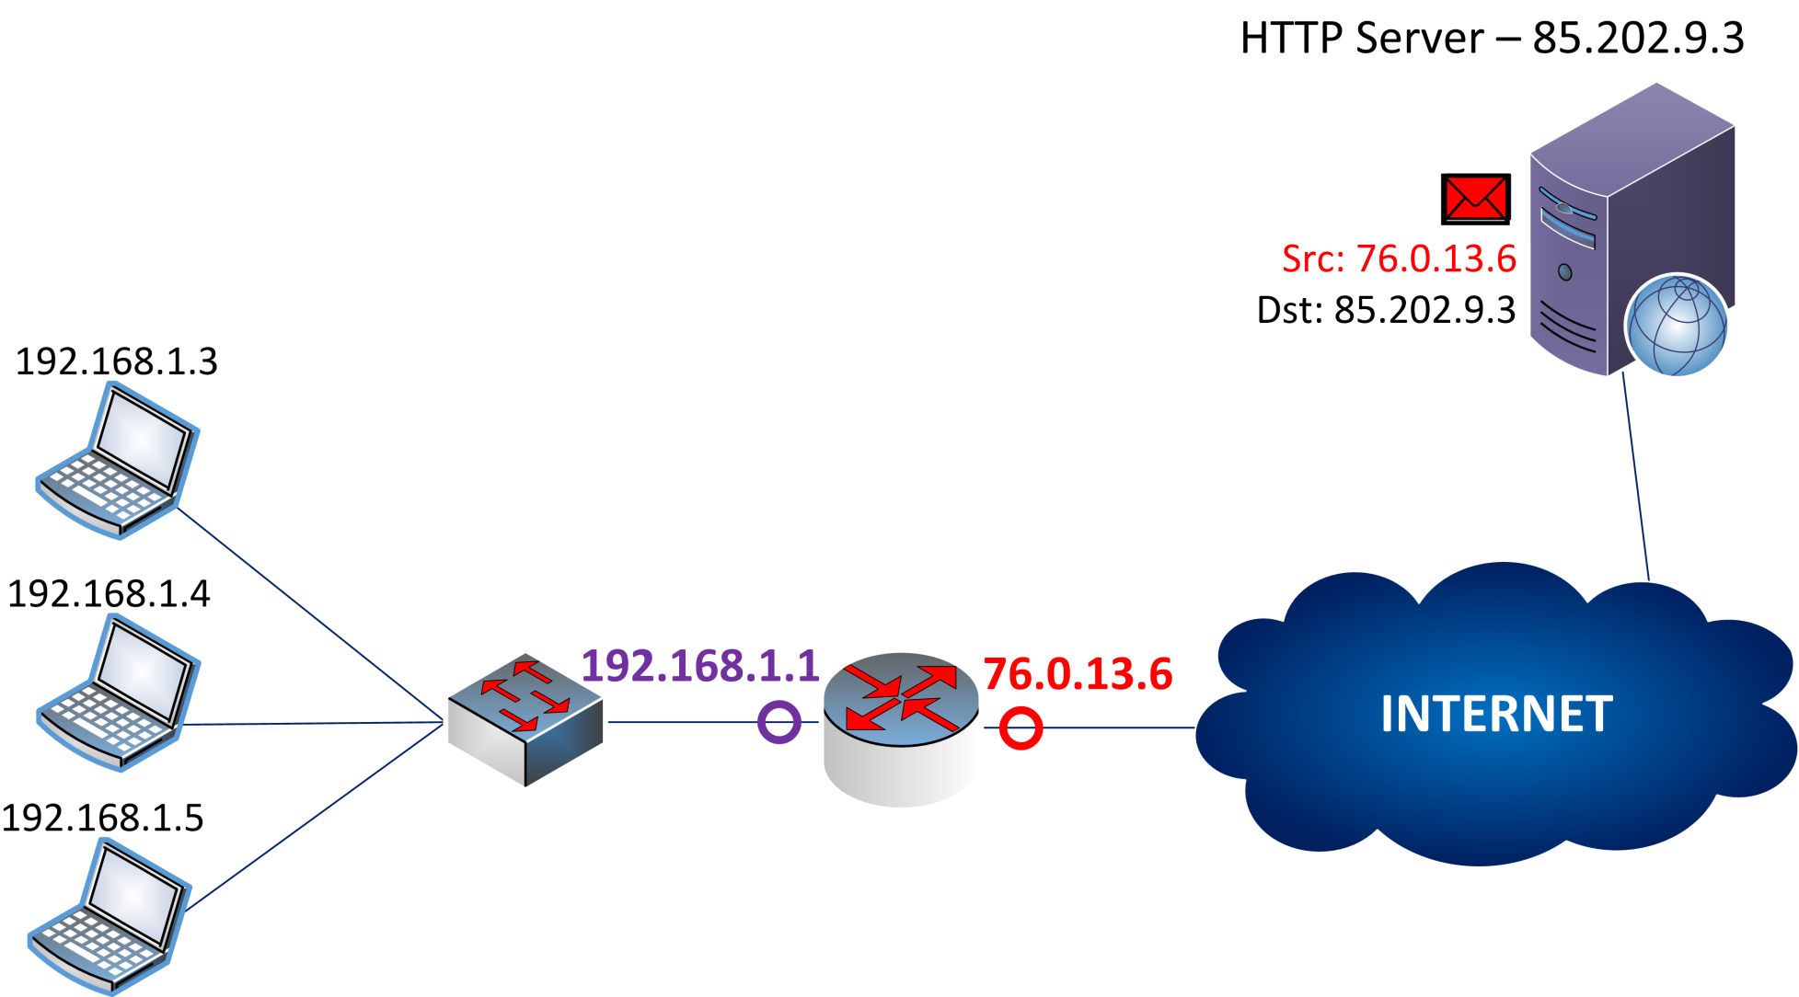
Network Address Translation (NAT)

Slide 31
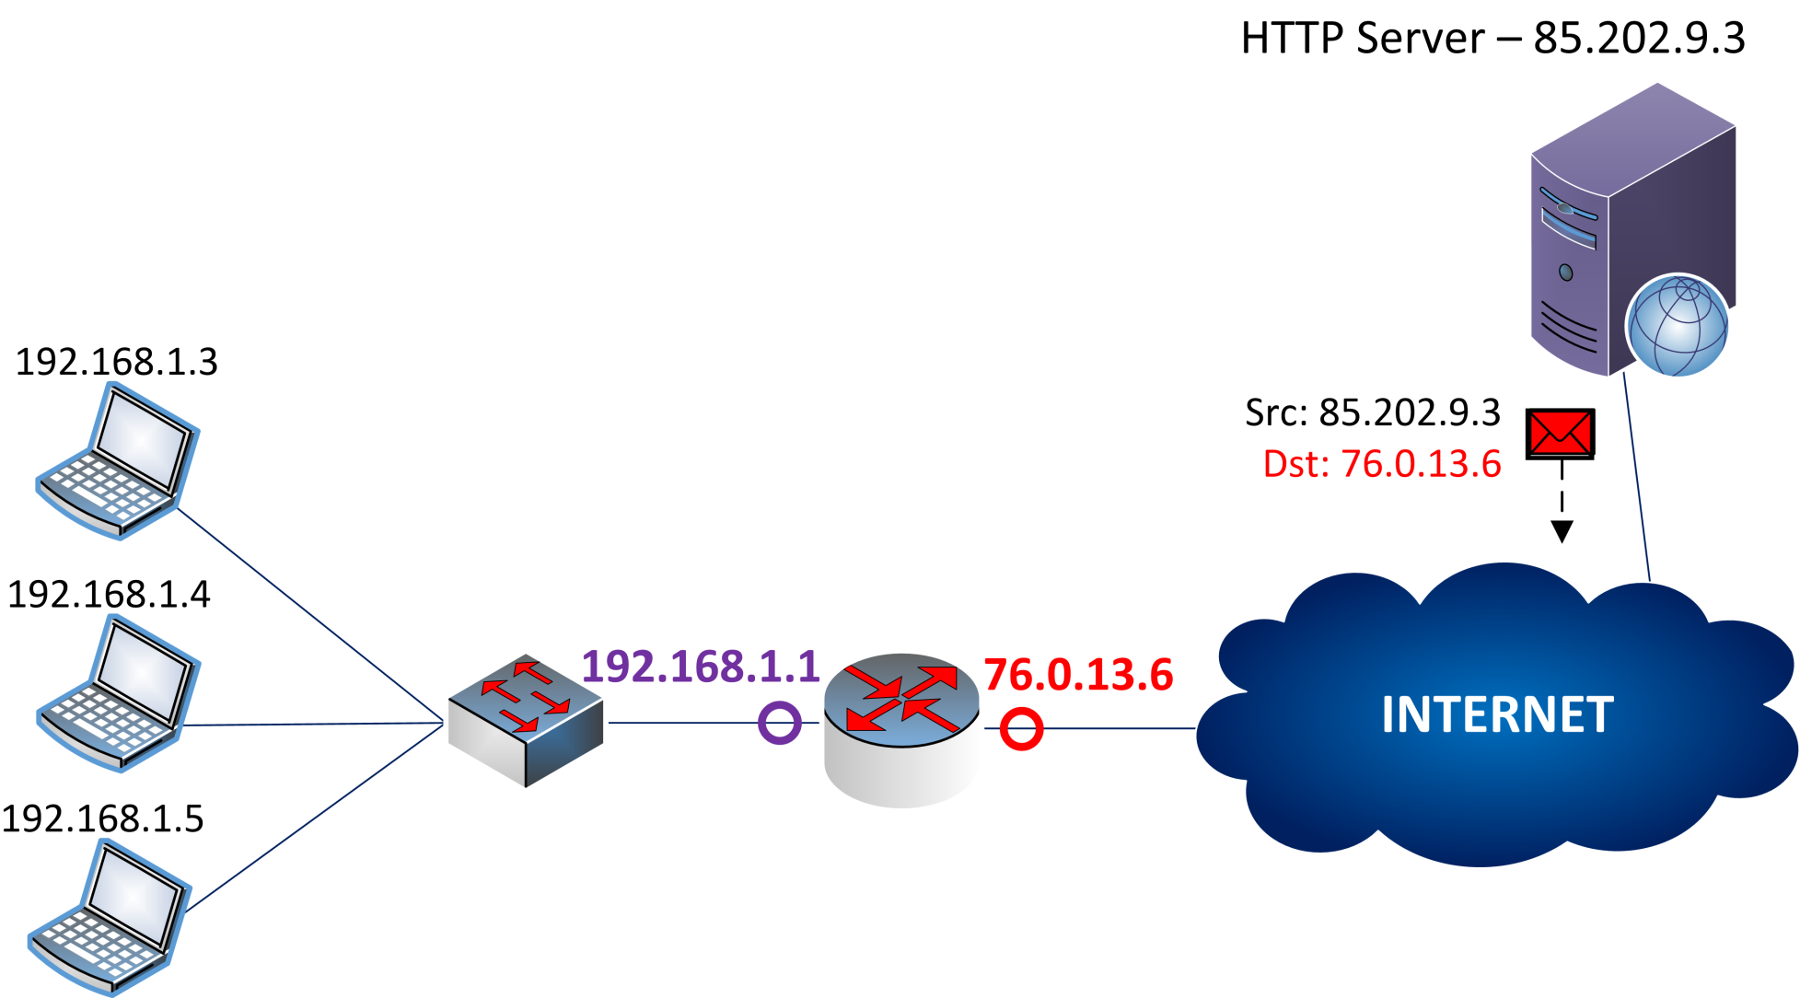
Network Address Translation (NAT)

Slide 32
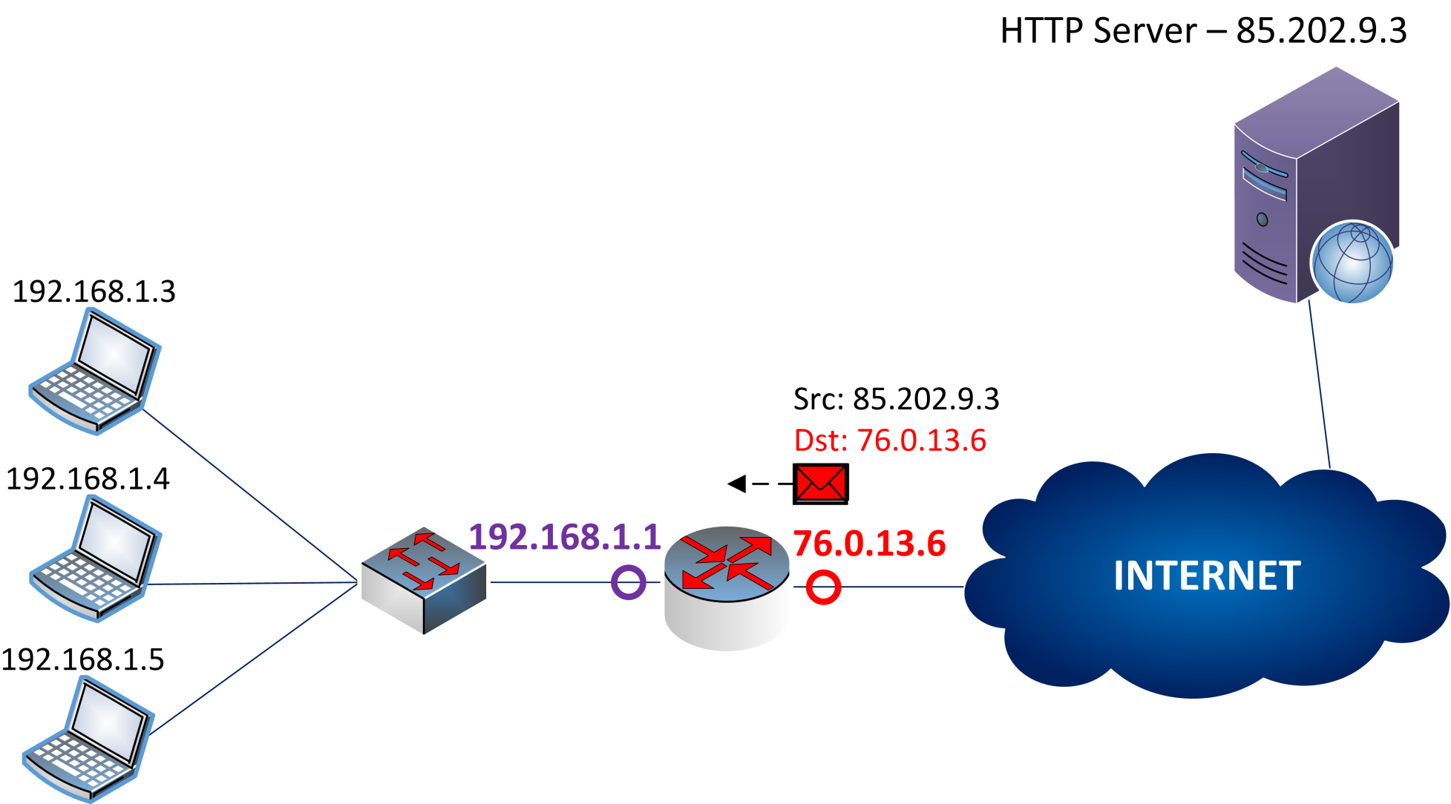
Network Address Translation (NAT)

Slide 33
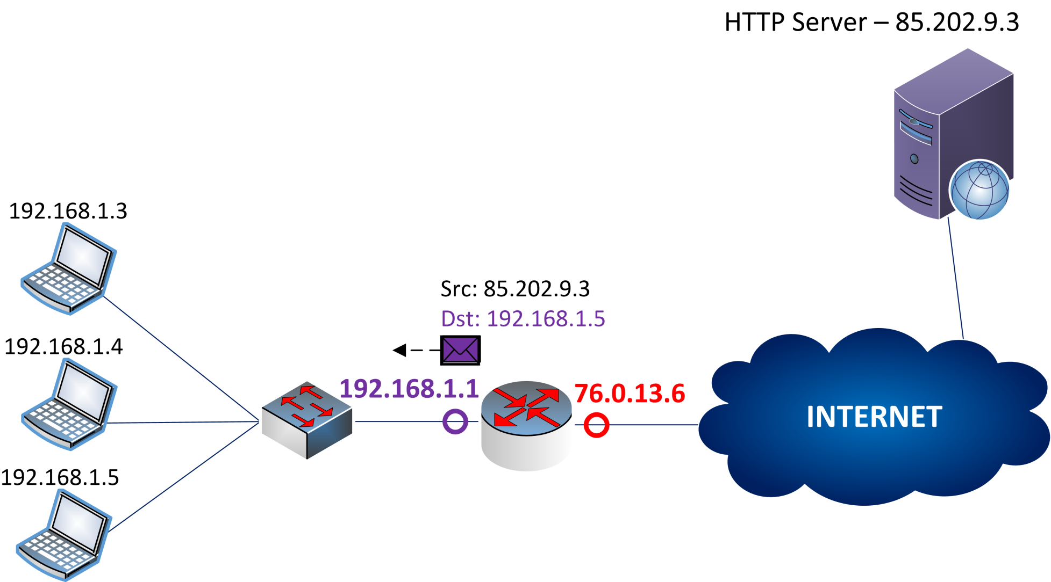
Network Address Translation (NAT)

Slide 34
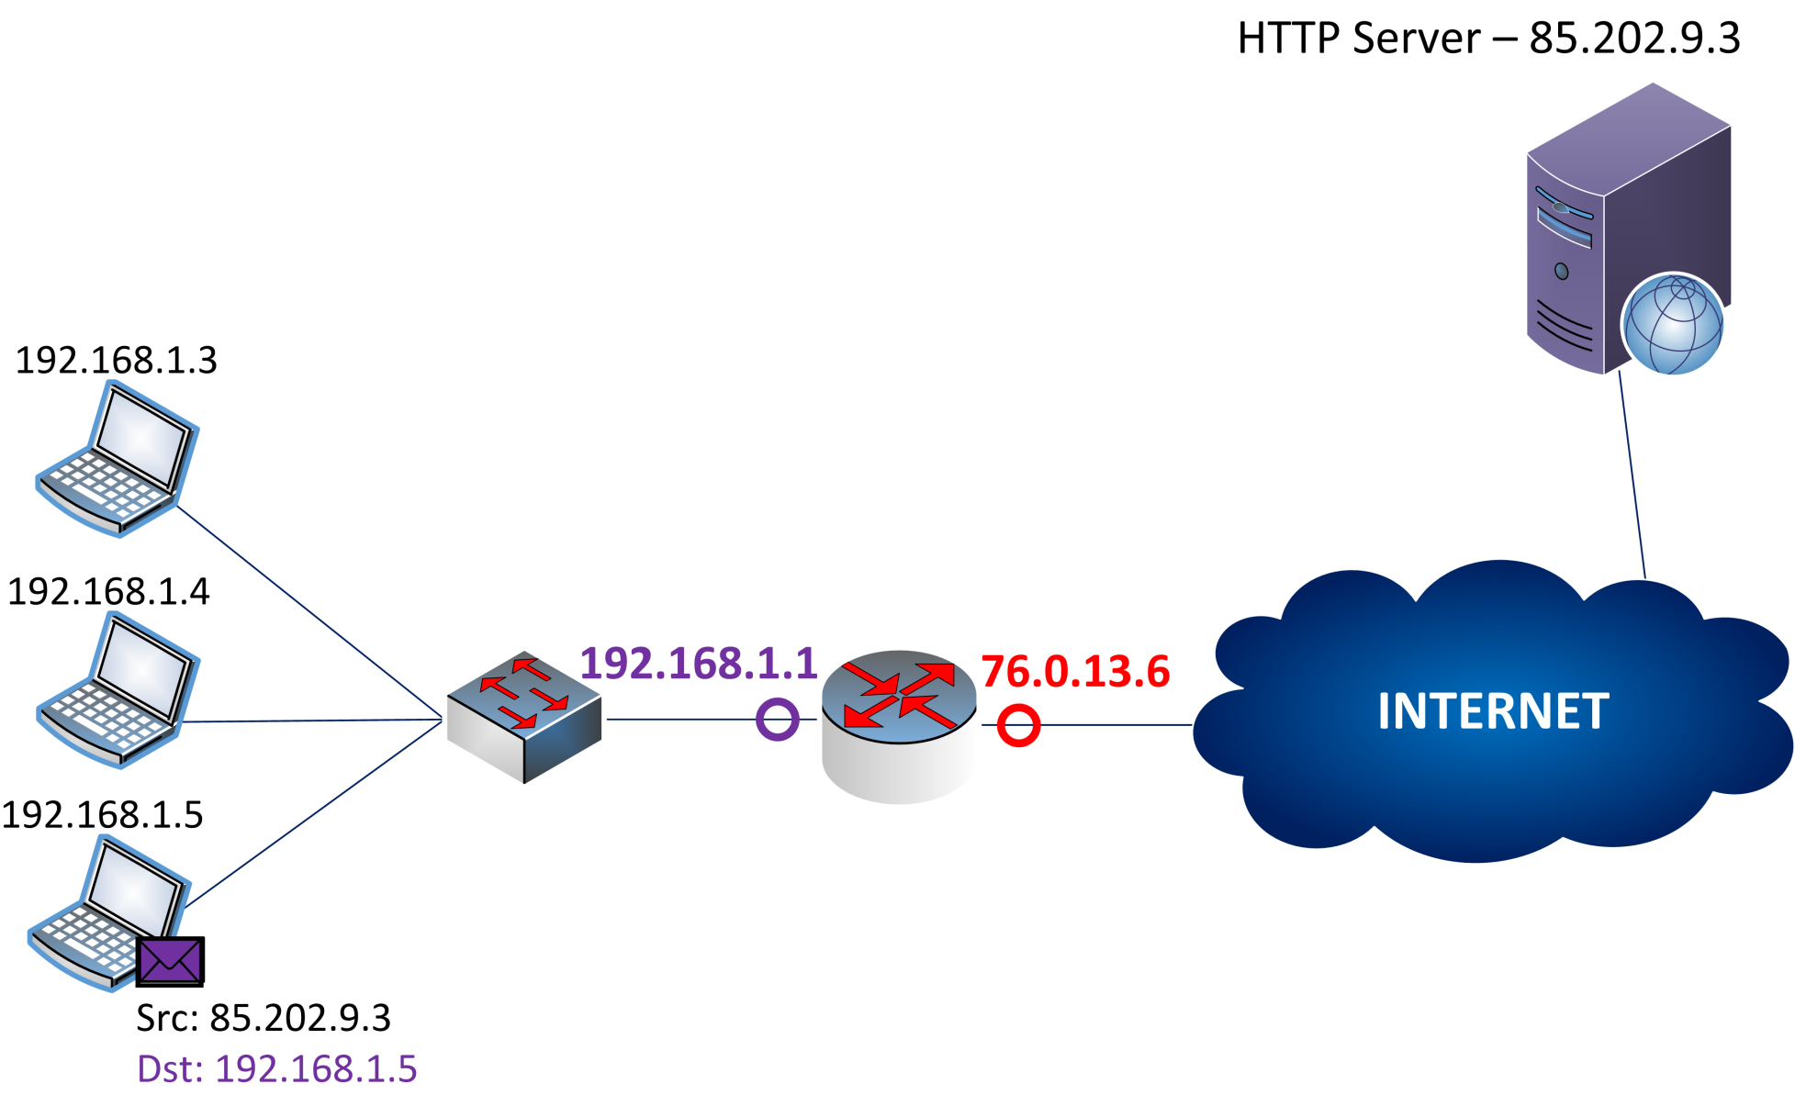
Network Address Translation (NAT)

